Slide 1
The Scrum-Agile Approach in SNHU Travel
Nicholas Boodoo
CS 250

Slide 2
The Scrum Team
Product Owner
Own a product in its entirety; they have the final word on strategic and tactical product decisions.
Scrum Master
Hold the scrum team accountable to their working agreements, scrum values, and to the scrum framework itself.
Scrum Team
Developers
Product Testers

Slide 3
Agile SDLC Methodology
Collaborative decision making.
Cyclical, iterative progression of producing working software.
Work is done in regularly iterated cycles
Sprints usually last two to four weeks.

Slide 4
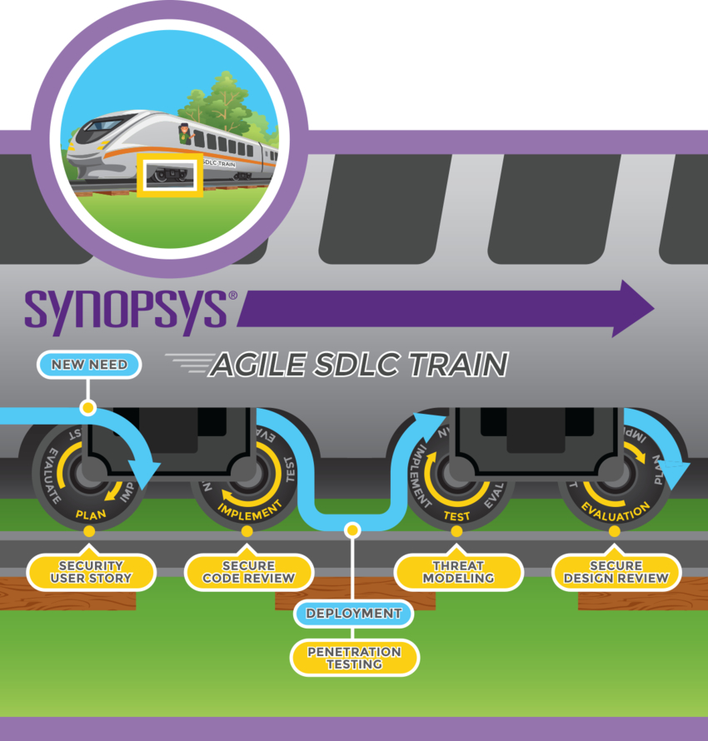
Agile SDLC Parts
User Story
Code review
Product testing
Design Review

Slide 5
Agile vs Waterfall
Agile
End goal can be unknown
Faster, high quality delivery
Better teamwork
Continuous improvement
Waterfall
Easy to use and manage
Requires well documented approach
Changes cannot be accommodated
Gathering accurate requirements can be challenging

Slide 6
Choosing Agile or Waterfall
Determine if you will need to make changes to the product
Waterfall does not accommodate for changes
Determine if you have a well balanced team
Agile requires a lot of teamwork

Slide 7
Bibliographies
1: Institute™, International Scrum. “Scrum Roles – the Scrum Team - International Scrum Institute.” International Scrum Institute™, International Scrum Institute™, 19 Nov. 2019, https://www.scrum-institute.org/Scrum_Roles_The_Scrum_Team.php.
2: “The Scrum Team Roles and Accountabilities [0.25 SEU].” Scrum Alliance Resources, https://resources.scrumalliance.org/Article/scrum-team.
3: “What's the Difference? Agile vs Scrum vs Waterfall vs Kanban.” Smartsheet, https://www.smartsheet.com/agile-vs-scrum-vs-waterfall-vs-kanban.

